Slide 1

Fraud Detection in Financial Transactions
Group -26
Team members
Hari Krishna Sai Rachuri
Vivek Nelluri
Sathwika Karingu
Krishna Anuhya Regalla

Slide 2

Related work with linked references
Intelligent Financial Fraud Detection Practices in the Post-Pandemic Era: This article provides a survey of intelligent financial fraud detection practices, analyzing new fraud risks as a result of the pandemic, as well as the development of data types used in fraud detection, that include statistical table data to various unstructured data.​
Intelligent financial fraud detection practices in post-pandemic era ....

Slide 3

Methodology

Slide 4
Problem Statement
"Developing an effective fraud detection system is essential to mitigate the growing financial losses caused by payment fraud, identity theft, and credit card fraud.
01
The rapid increase in digital transactions has led to an overwhelming volume of data, necessitating the use of advanced technologies such as Hadoop, Spark, and Hive for big data analytics.
02
This challenge requires the integration of machine learning, data processing, and real-time analytics to build a robust solution that combats fraud effectively."
03

Slide 5
Workflow to Implement this project
Data Visualization through Python Libraries such as Matplotlib and presenting histograms
Data Preprocessing on Hive using Cloudera
After, Data Preprocessing we can work on the dataset to carry out the machine learning algorithm using Pyspark
Implementation of Spark code in aws using EMR ON EC2 to run the code.
Presenting the final output

Slide 6
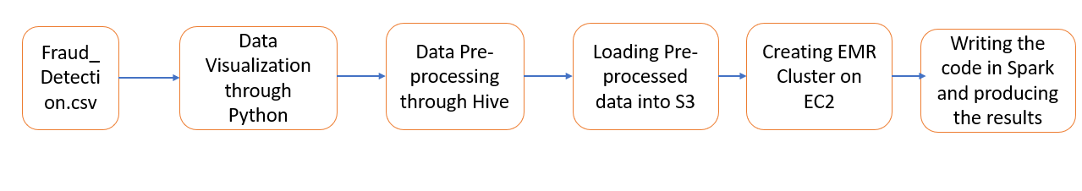




Architectural Diagram

Slide 7

Structure of Dataset

Slide 8
Dataset Contents
Step – It’s a integer Data Type which refers to transactions numbering
Type – It’s a String Data Type which contains the payment mode
Amount – Integer or Float value with amount
nameOrig - This column likely represents the originating account or entity's name or identifier. It identifies the source of the transaction.
oldbalanceOrg – Integer value with amount before transaction
newbalanceOrig: Following the transaction, the balance in the originating account is shown in this column. It displays the account balance following a payment or transfer of funds.
nameDest: This field most likely contains the name or identification of the destination account or entity. It indicates who the transaction's recipient or destination is.
oldbalanceDest: The balance in the destination account prior to the transaction is shown in this column. It shows the amount in the recipient's account prior to the funds being sent.
newbalanceDest: Following the transaction, the balance in the destination account is shown in this column. It displays the recipient's account balance following the money transfer.
isFraud- An single integer to state whether the transaction is Fraud or not
isFlaggedFraud – This is also similar to the above variable, It's a potential additional fraud detection measure.

Slide 9

Explanatory Data Analysis

Slide 10
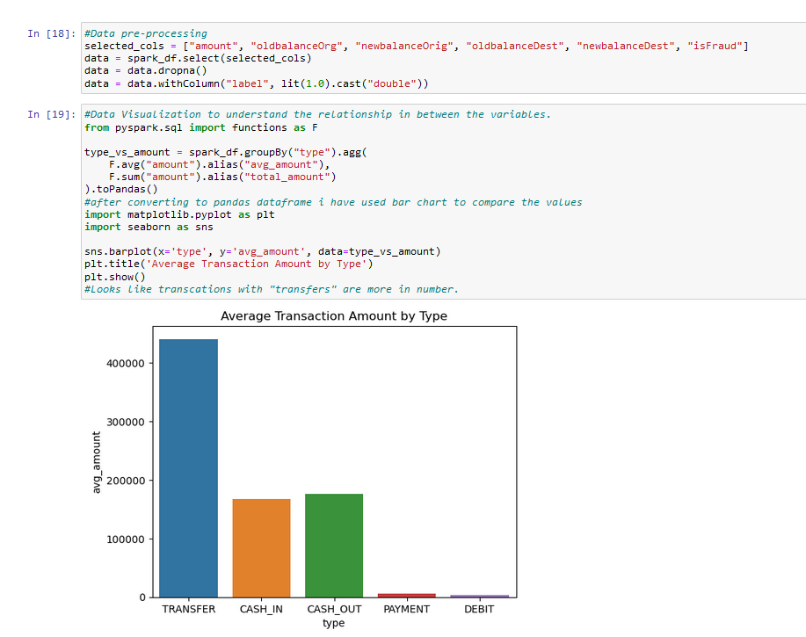
Data Visualization through Python

Slide 11
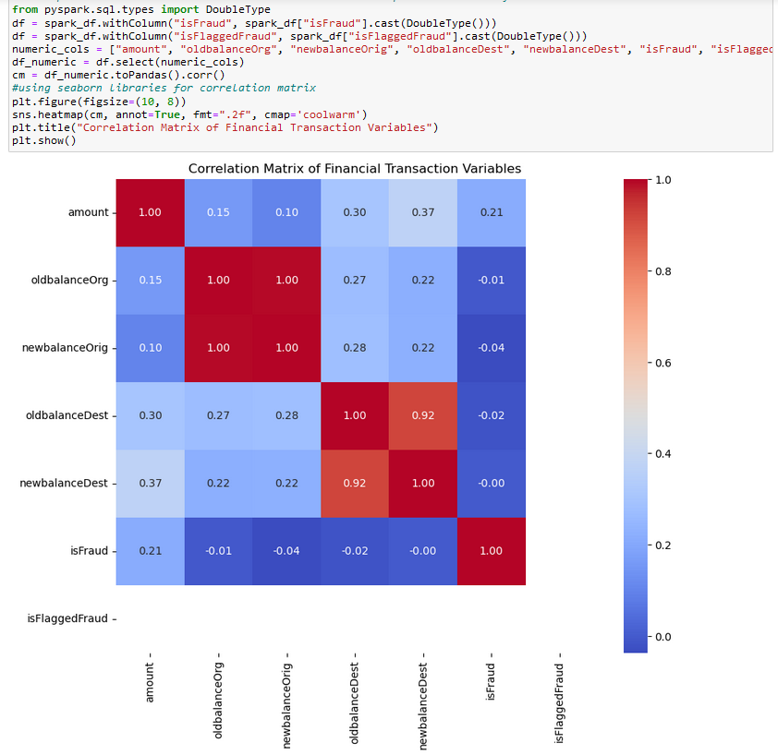
Correlation matrix towards “is Fraud” Variable

Slide 12
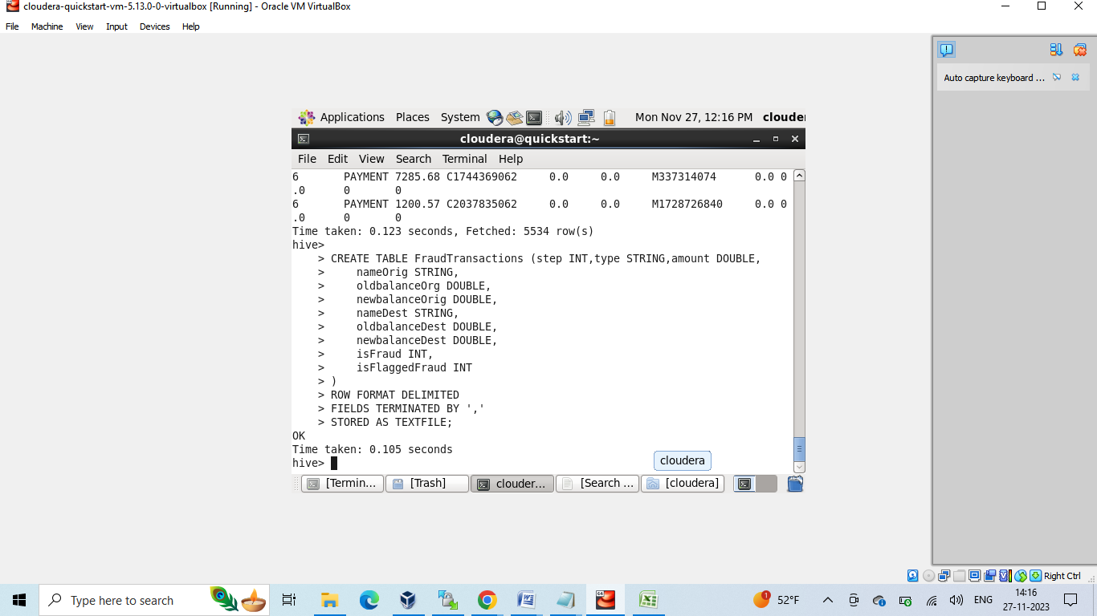
Data Pre- Processing using Hive
Setup Hive in the Cloudera Platform and create a empty table with the schema as it is present in the csv file.

Slide 13
Performing the Following SQL Queries
This query calculates the average transaction amount for each transaction type. - 1st question
Money laundering transactions may involve multiple transfers with small amounts. You can identify such patterns by grouping transactions by nameOrig and calculating the total number of outgoing transactions and the total amount transferred for each account
Based on your fraud detection criteria, you can flag transactions that meet certain conditions as potentially fraudulent. For example, transactions where isFraud is not flagged but the amount is significantly higher than average.

Slide 14
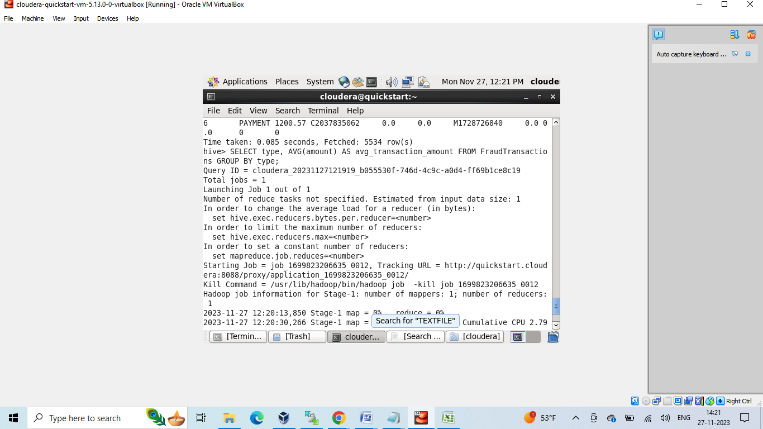
The following are the outputs of the given SQL Queries

Slide 15
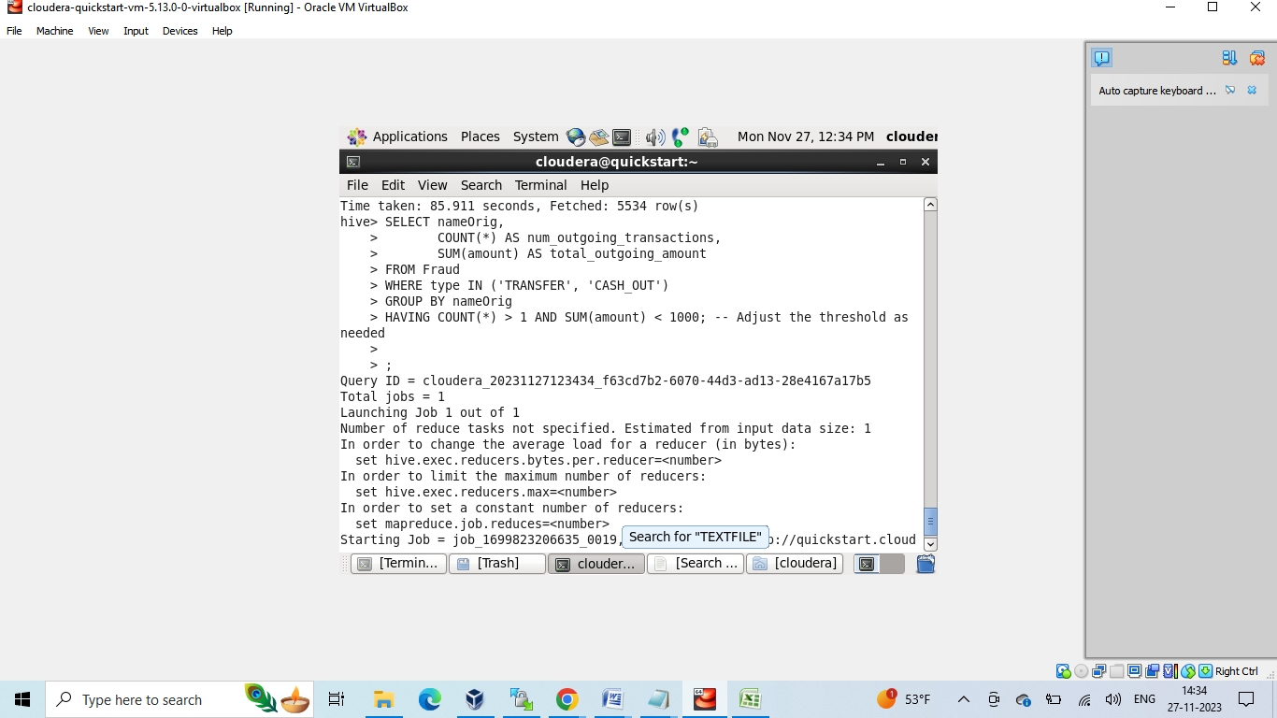
Output-02

Slide 16
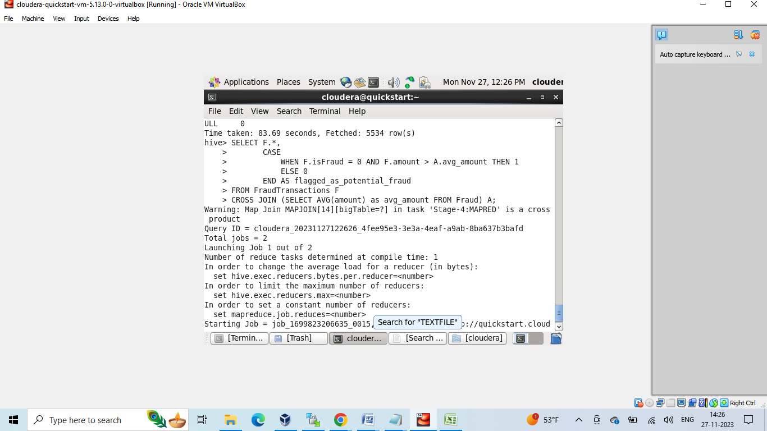
Output-03

Slide 17

Implementation

Slide 18

Implementation of the Project
We need to run our Spark code using EMR cluster on EC2 instance.
First we need to create a cluster on EMR and launch the cluster using the EC2 instance which was created
We need to make sure to check with the security groups and change the in bound rules. Along with that we need to check with the security groups
Create IAM role to give access to the specific roles.
Then it would take a couple of minutes to get started with cluster creation

Slide 19
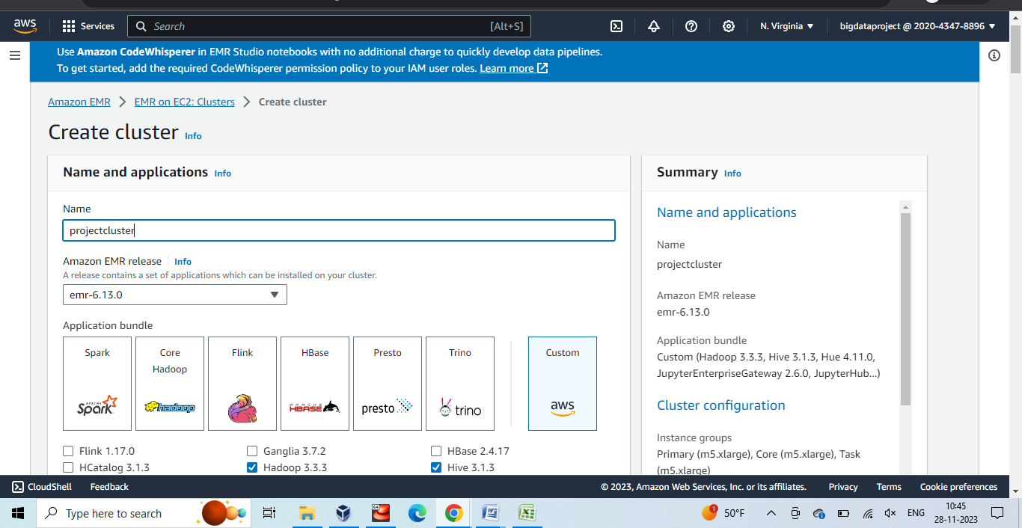
Cluster Creation

Slide 20
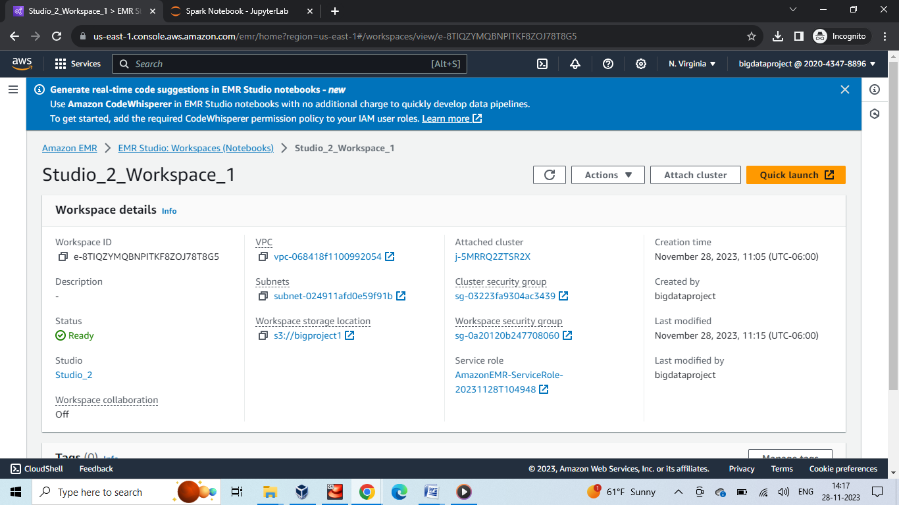
Workspace Creation

Slide 21
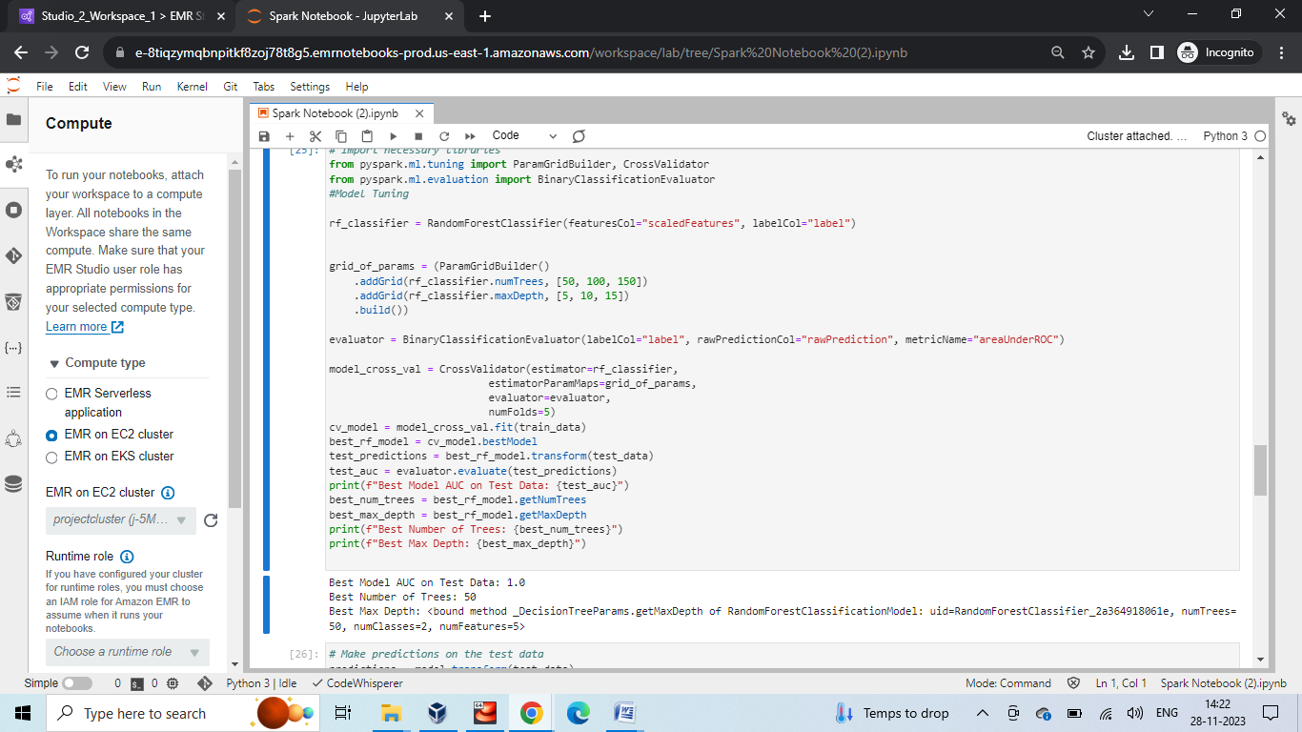
Opening the Jupyter Notebook to run the Code

Slide 22

Machine Learning Model
As per the correlation matrix suggests that amount variable has higher tendency towards isfraud and looks like higher the amount, there is more chance of fraudulent activities
we cannot come to a conclusion based on correlation matrix,
we need to combine all the features using random forest classifier
Because the Random Forest classifier is sensitive to feature scale, it could not function effectively if the features are distributed across several sizes.
The Random Forest technique can make better use of the characteristics and perhaps enhance the model's capacity to discriminate between fraudulent and non-fraudulent transactions by standardizing the features (scaling them to have zero mean and unit variance).

Slide 23
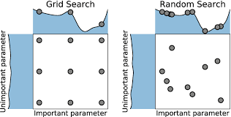
Hyper Parameter Tuning
Creating a grid of hyperparameters allows you to explore a wide range of potential settings within the specified parameter ranges. This systematic exploration helps ensure that you do not miss potentially better combinations.
We need to create a grid of hyperparameters to be explored during the hyperparameter tuning process. This specifies different values for the number of trees (numTrees) and the maximum depth of the trees (maxDepth). For example, this function considers 3 values for numTrees (50, 100, 150) and 3 values for maxDepth (5, 10, 15), resulting in a total of 9 different combinations.

Slide 24

Results

Slide 25
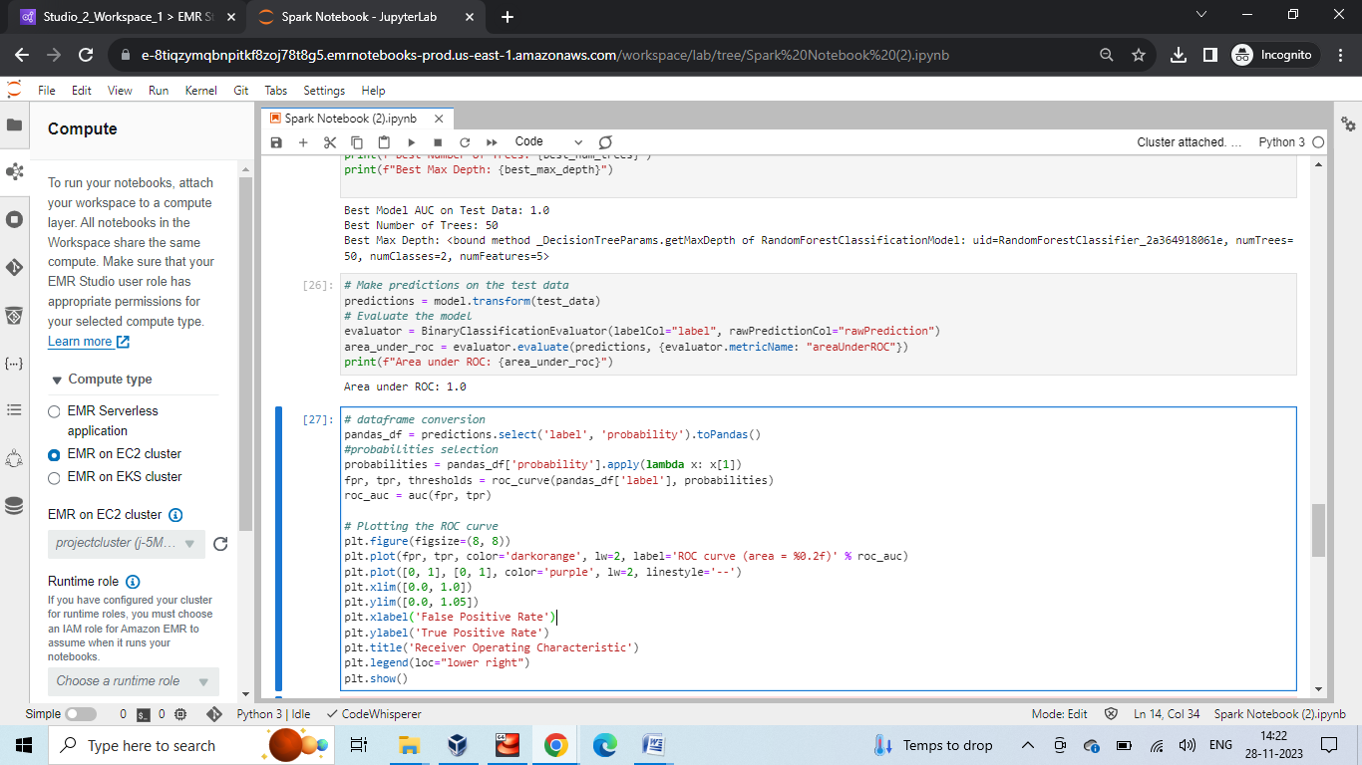
Output

Slide 26
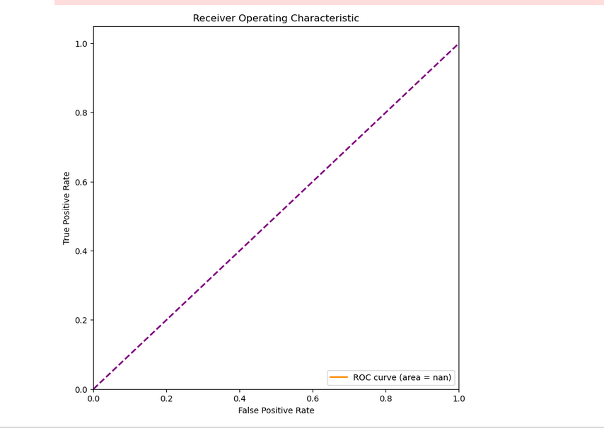
Final Results and Validation through Area Under ROC Curve
The ROC curve provides a visual representation of a model's performance in distinguishing between two classes (e.g., positive and negative cases). It allows you to assess the model's ability to differentiate between true positives (correctly predicted positive cases) and false positives (incorrectly predicted positive cases) across different probability thresholds.

Slide 27

Conclusion
The area under ROC curve indicates that 1 which indicates a perfect classifier
The “evaluate method” of the evaluator computes the metric specified for the model predictions provided.
In this case, {evaluator.metricName: "areaUnderROC"} sets the metric to the Area Under the ROC Curve (AUC - ROC).
This results helped to me to decide that it’s the best classifier and this algorithm can able to train on the given data set and produced the best results. This is more a like a validation method for this project.
The AUC - ROC is a single scalar value that summarizes the performance of the binary classification model across all classification thresholds.
It essentially measures the ability of the model to discriminate between the two classes.
In conclusion, one of the most important steps in assessing and comprehending the effectiveness of a binary classification model is to create a ROC curve. It enables threshold setting, makes model comparison easier, and offers insights into the discriminating strength of the model.

Slide 28

Project Management

Slide 29

Implementation Status Report :
Description :
We are a team of 4 people working on the fraud transactions detection model. We have implemented Random Forest classifier to train our model in pyspark and Python Responsibility:
Sathwika – (Team Lead) Helped in building the EMR cluster and working throughout the Notebook.
Anuhya – Worked on the Data Visualization
Vivek – Data Preprocessing through Hive. Hari - Writing the code for training the model and Hyper tuning parameters.

Slide 30
Contributions:
Sathwika took 25 percent of the project contribution in making the report and the presentation for the project. She is responsible with AWS and Cloudera setup.
Anuhya took 25 percent of the project contribution in making the report and the presentation for the project and also performed Data Visualization using python until the data Preprocessing steps
Vivek- took 25 percent of the project contribution in making the report and the presentation for the project and have written code in SQL.
Hari - took 25 percent of the project contribution in making the report and the presentation for the project and have written code in Python.

Slide 31
Issues/ Concerns:
We could have performed more on Hive. We have rather focused on Machine Learning and testing the model instead of working more on preprocessing part. That’s our major concern in this project.

Slide 32
References
1."Big Data Analytics: Turning Big Data into Big Money" by Frank J. Ohlhorst - Offers insights into leveraging big data technologies like Hadoop and Spark for fraud detection.
2.Title: "Real-time Financial Fraud Detection Using Big Data Technologies."
Authors: Ho, Y. H., & Zhao, Z.
Published in: Journal of Financial Crime, 2017.
3.Title: "Fraud Detection in Hadoop Ecosystem: A Comprehensive Review."
Authors: Garg, K., Arora, S., & Tripathi, G.
Published in: Procedia Computer Science, 2017.
Fraud detection through Spark – https://subscription.packtpub.com/book/data/9781783980307/3

